Slide 1
Requirement Document
Login page for a portal

Slide 2
FUNCTIONALITY
Allow new users to enter the details to register into the portal, which are stored in a database.
Allow existing users to enter username and the respective password which are validated against a database.
The system should validate the entered details against a database.
If the credentials are correct, the user should be redirected to their dashboard, according to the roles specified.
If the credentials are incorrect, appropriate error message such as “User name does not exist” or “Incorrect password” should be produced.

Slide 3
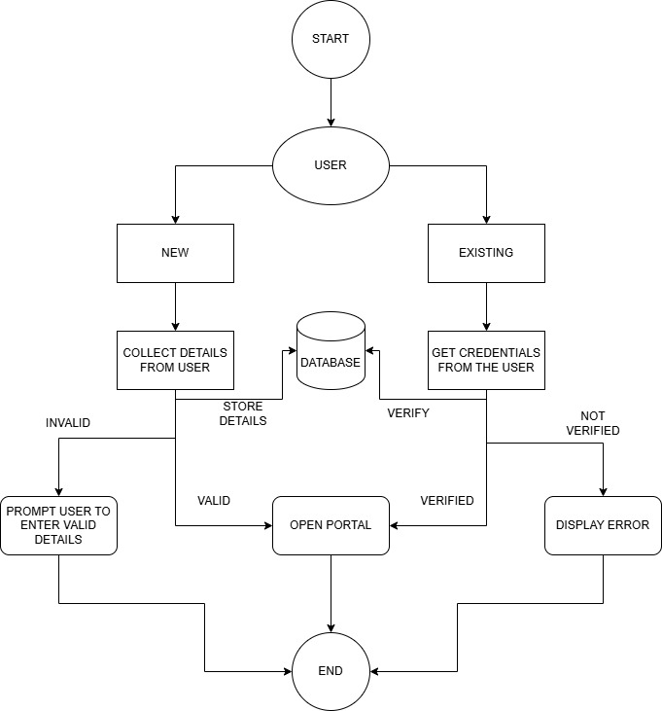
WORKFLOW

Slide 4
WORKFLOW
New User
Ask user to enter all the details.
Verify the user using OTP through mobile.
Update the details in the database.
According to the specified role, show the respective dashboard of the user (student/admin).
Existing User
Get the login credentials from the user.
Validate the details against the database.
If valid user, open the portal and if the details are incorrect display appropriate error messages.

Slide 5
Possible cases
New Admin/User registration
Get the details from the user such as username, password, userID, email, etc.
Check the userID from the database and if the details are valid, store the details in the database.
If invalid details are entered ask user to enter valid details or contact owner if there is a problem in registering.
After proper registration, allow user to access the portal.

Slide 6
Possible cases
Existing Admin/User login
Ask user to enter proper credentials.
Check the details such as userID from the database and if the details are valid, open the respective portal.
If the details are invalid show proper error messages such as “Invalid username” or “Incorrect password”.

Slide 7
ADDITIONAL FEATURES
Password reset option should be given if the user forgets or wants to reset their password.
Two-Factor Authentication can be implemented by sending OTP for verification.
Captcha can be integrated to avoid brute-force attacks by bots.
After a set number of incorrect entry, account locking or cooldown timer could be enabled.

Slide 8
REQUIREMENTS
Front-end: Technologies like HTML, CSS or Bootstrap for user interface.
Back-end: Server-side technologies such Node.js etc.
Database: Specific databases such as MySQL to store and process the details.
Framework: The required framework for the page using React.

